Slide 1
CDS-DCC Student Orientation DCC: Department Curriculum Committee DCC Convenor: Dr. Phani Motamarri DCC Members: Dr. Yogesh Simmhan, Dr. Sathish Vadhiyar, Dr. Chirag Jain, Dr. Aditya Konduri, Dr. Anirban Chakraborty
Student Representatives:
MTech: Naman Pesricha <namanp@iisc.ac.in>; Diksha Seth <dikshaseth@iisc.ac.in>
MTech(Research): Maunil Hitesh Shah <maunilshah@iisc.ac.in>, Parvesh Barak <parveshbarak@iisc.ac.in>
PhD: Biswarup Karmakar <biswarupk@iisc.ac.in>; Abhipsa Basu <abhipsabasu@iisc.ac.in>
Key information for incoming CDS students
(also available on CDS website -> Resources -> Students)

Slide 2
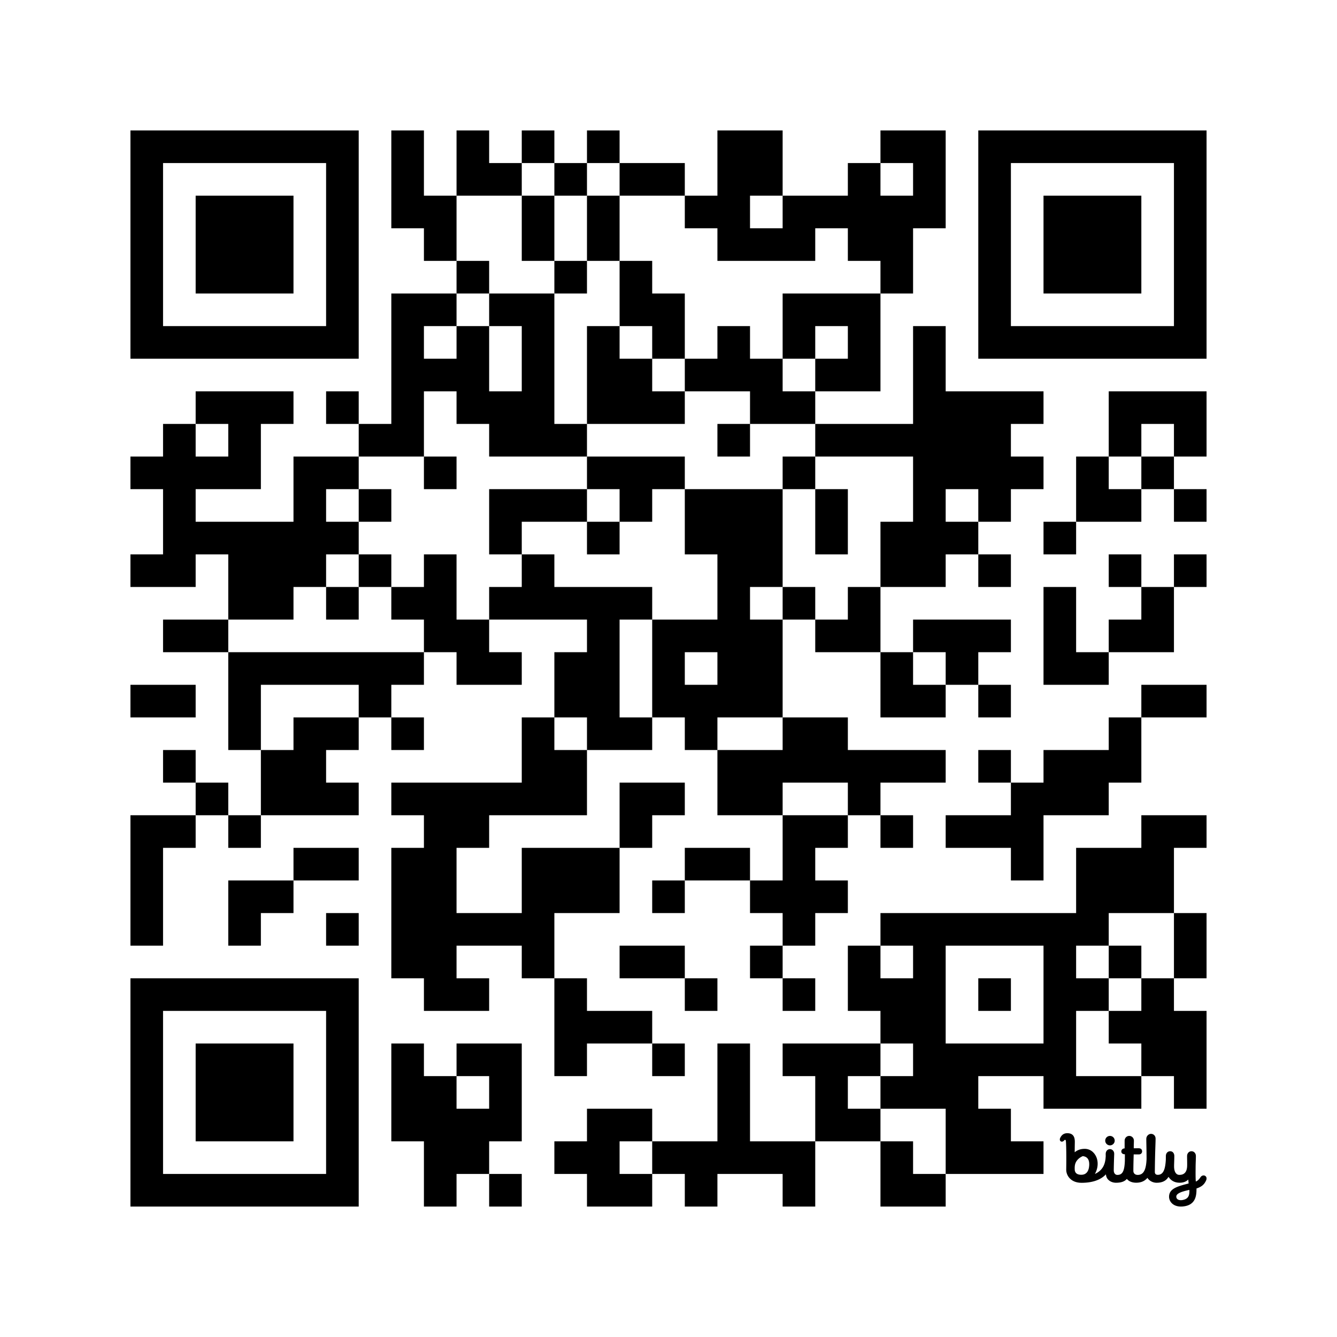
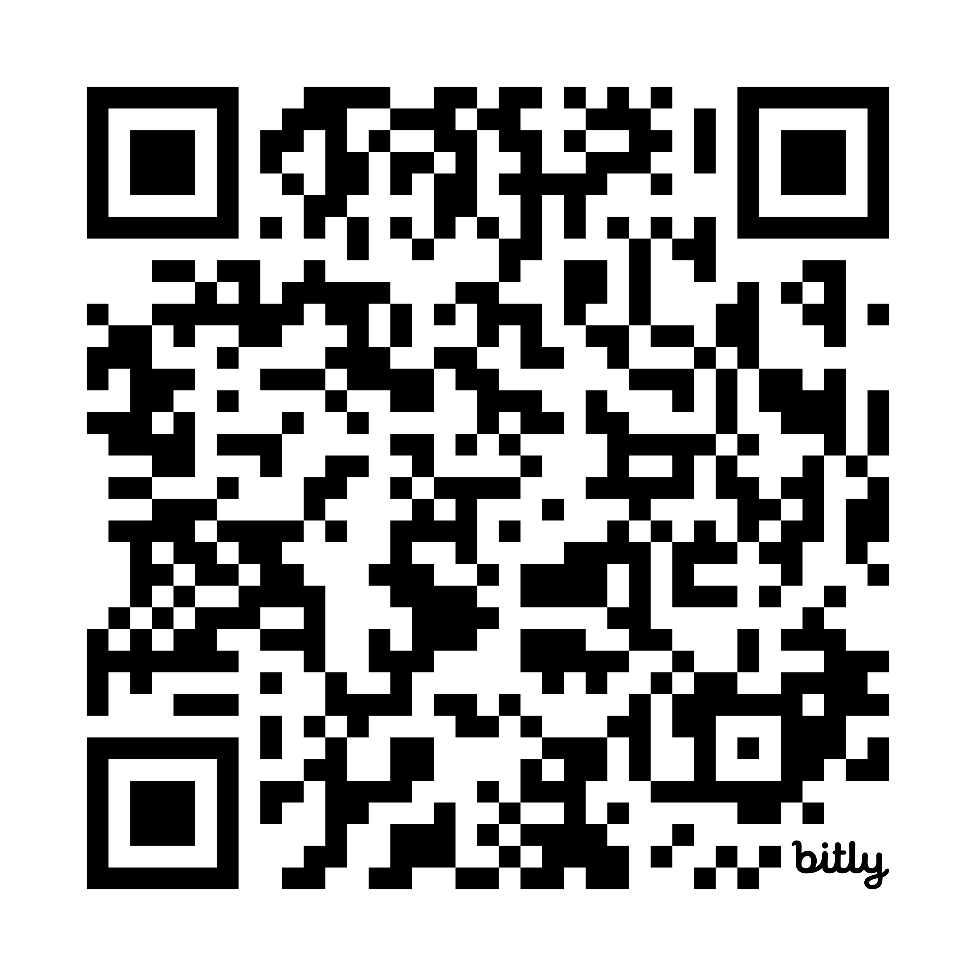
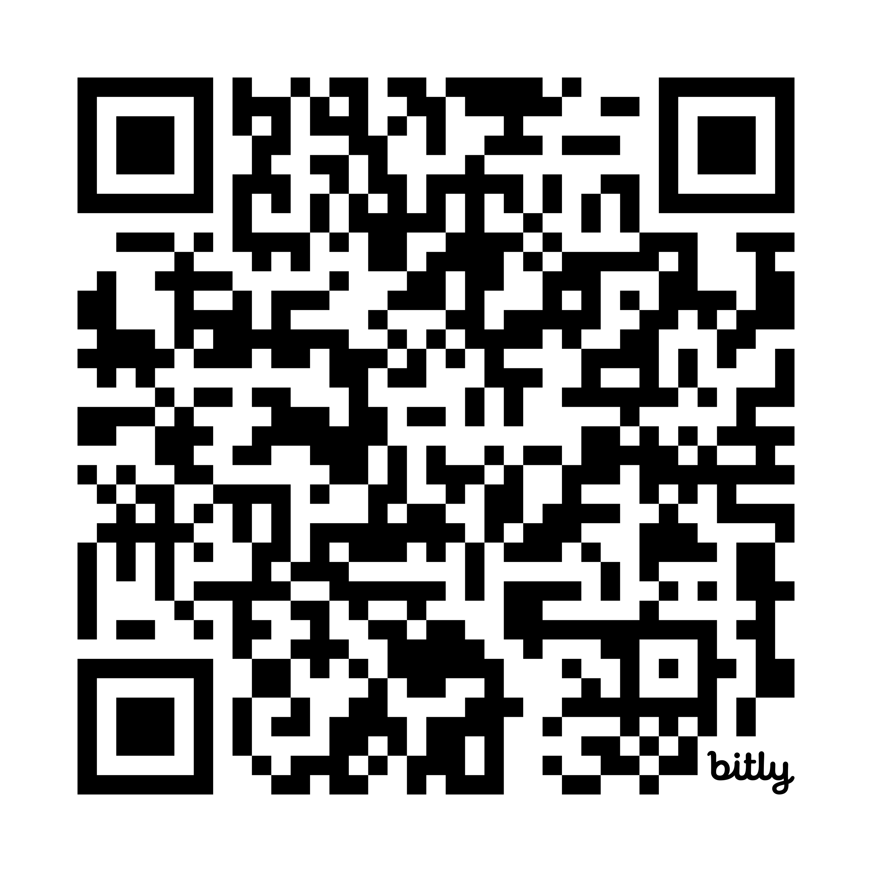
Important Academic Details
Student Handbook (for each incoming batch, https://bit.ly/iisc-sih-2025)
Rules and regulations applicable to you at IISc
Scheme of Instructions (annual/per-term, https://bit.ly/iisc-soi-2025-aug )
Courses expected to be offered in each department, faculty
Course Time-Table (each semester)
Schedule of courses actually offered, and final exam dates
Confirm with department page/instructor
https://cds.iisc.ac.in/courses/schedule/
Check department website/broadcast mail for first lecture date/venue

Slide 3
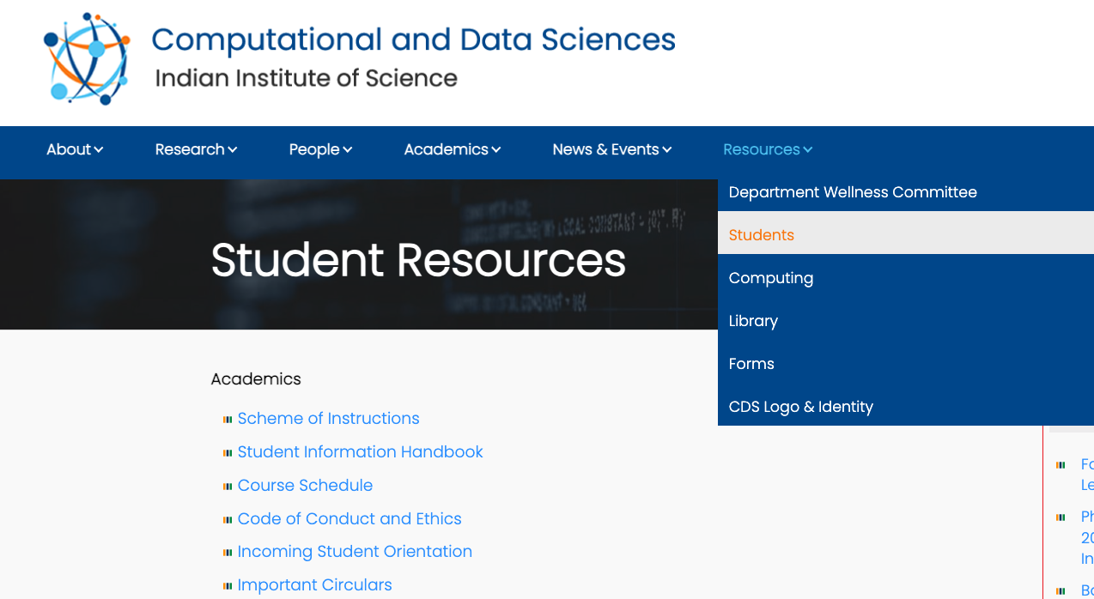
Important Academic Details

Slide 4
Courses@IISc
Course Code
XY zzz … E.g. DS 200, E0 253
XY: Department/Division offering course, e.g. DS=CDS, E0=CSA
zzz: course number and level. 200 level is beginner, 300 level is advanced
Credits
n:m … E.g. 3:1, 3:0, 2:0
n: number of lecture hours per week. 3 is typically 2*1.5hrs or 3*1hr. 2 is typically 2*1hr or 1*2hrs.
m: Lab effort required (highly variable by course). May include project component, tutorials, programming homeworks
Total credits for a course is m+n

Slide 5
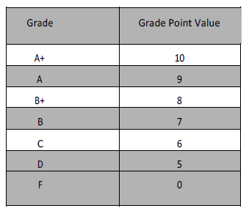
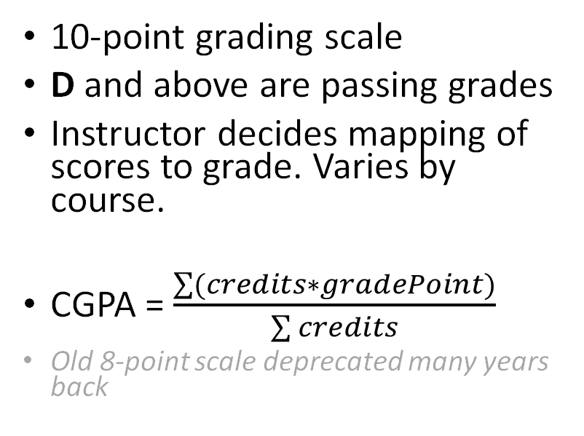
Courses@IISc
10-point grading scale
D and above are passing grades
Instructor decides mapping of scores to grade. Varies by course.
CGPA = $\frac{\sum{(credits∗gradePoint)}}{\sum{credits}}$
Old 8-point scale deprecated many years back
Attendance Policy depends on course and instructor. May require 75% or more to complete the course. Encourage you to attend lectures regularly to ensure progress.

Slide 6
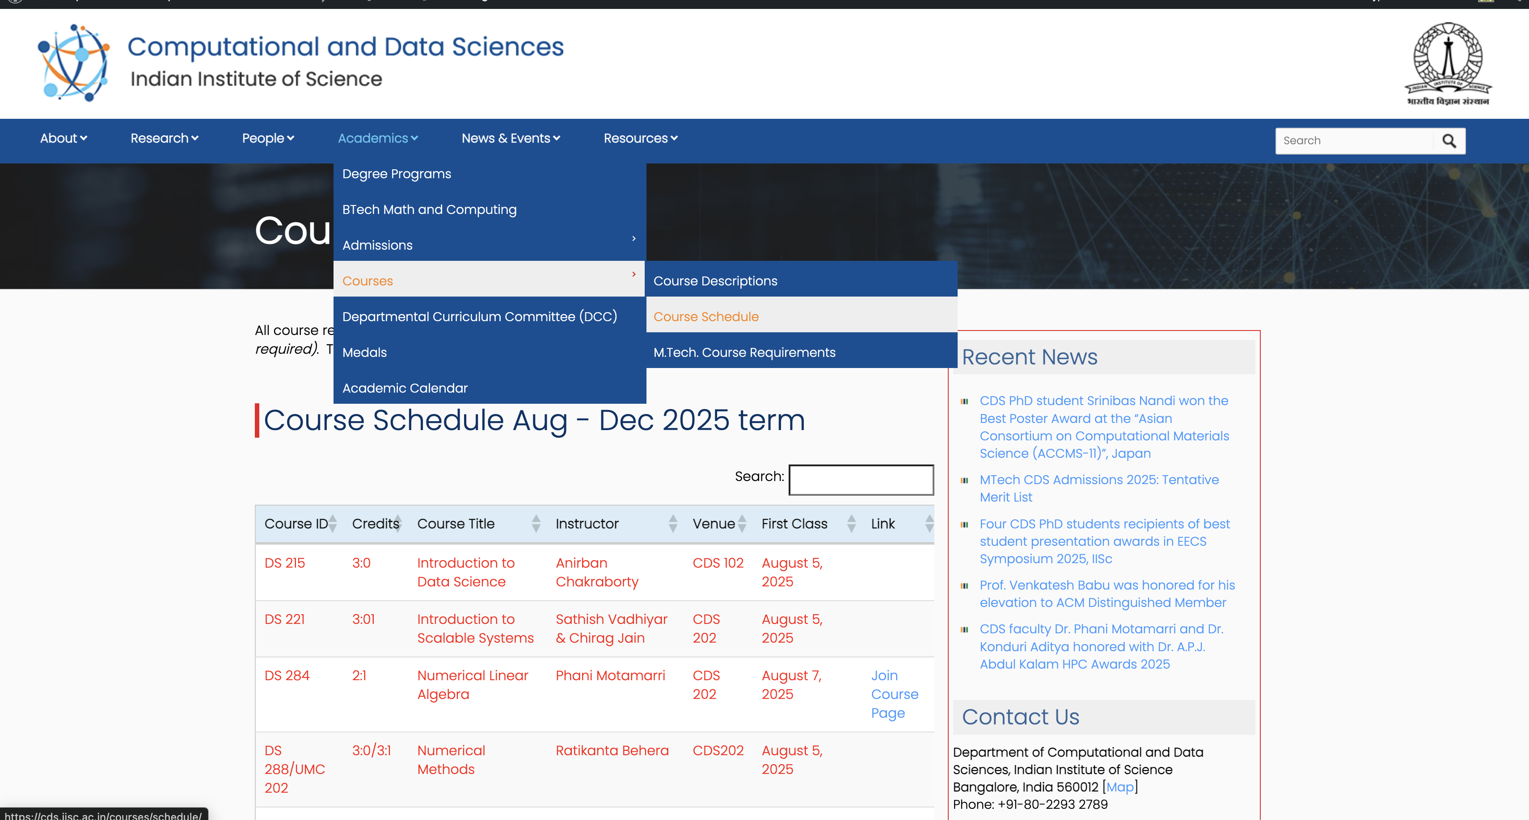
https://cds.iisc.ac.in/courses/schedule/

Slide 7
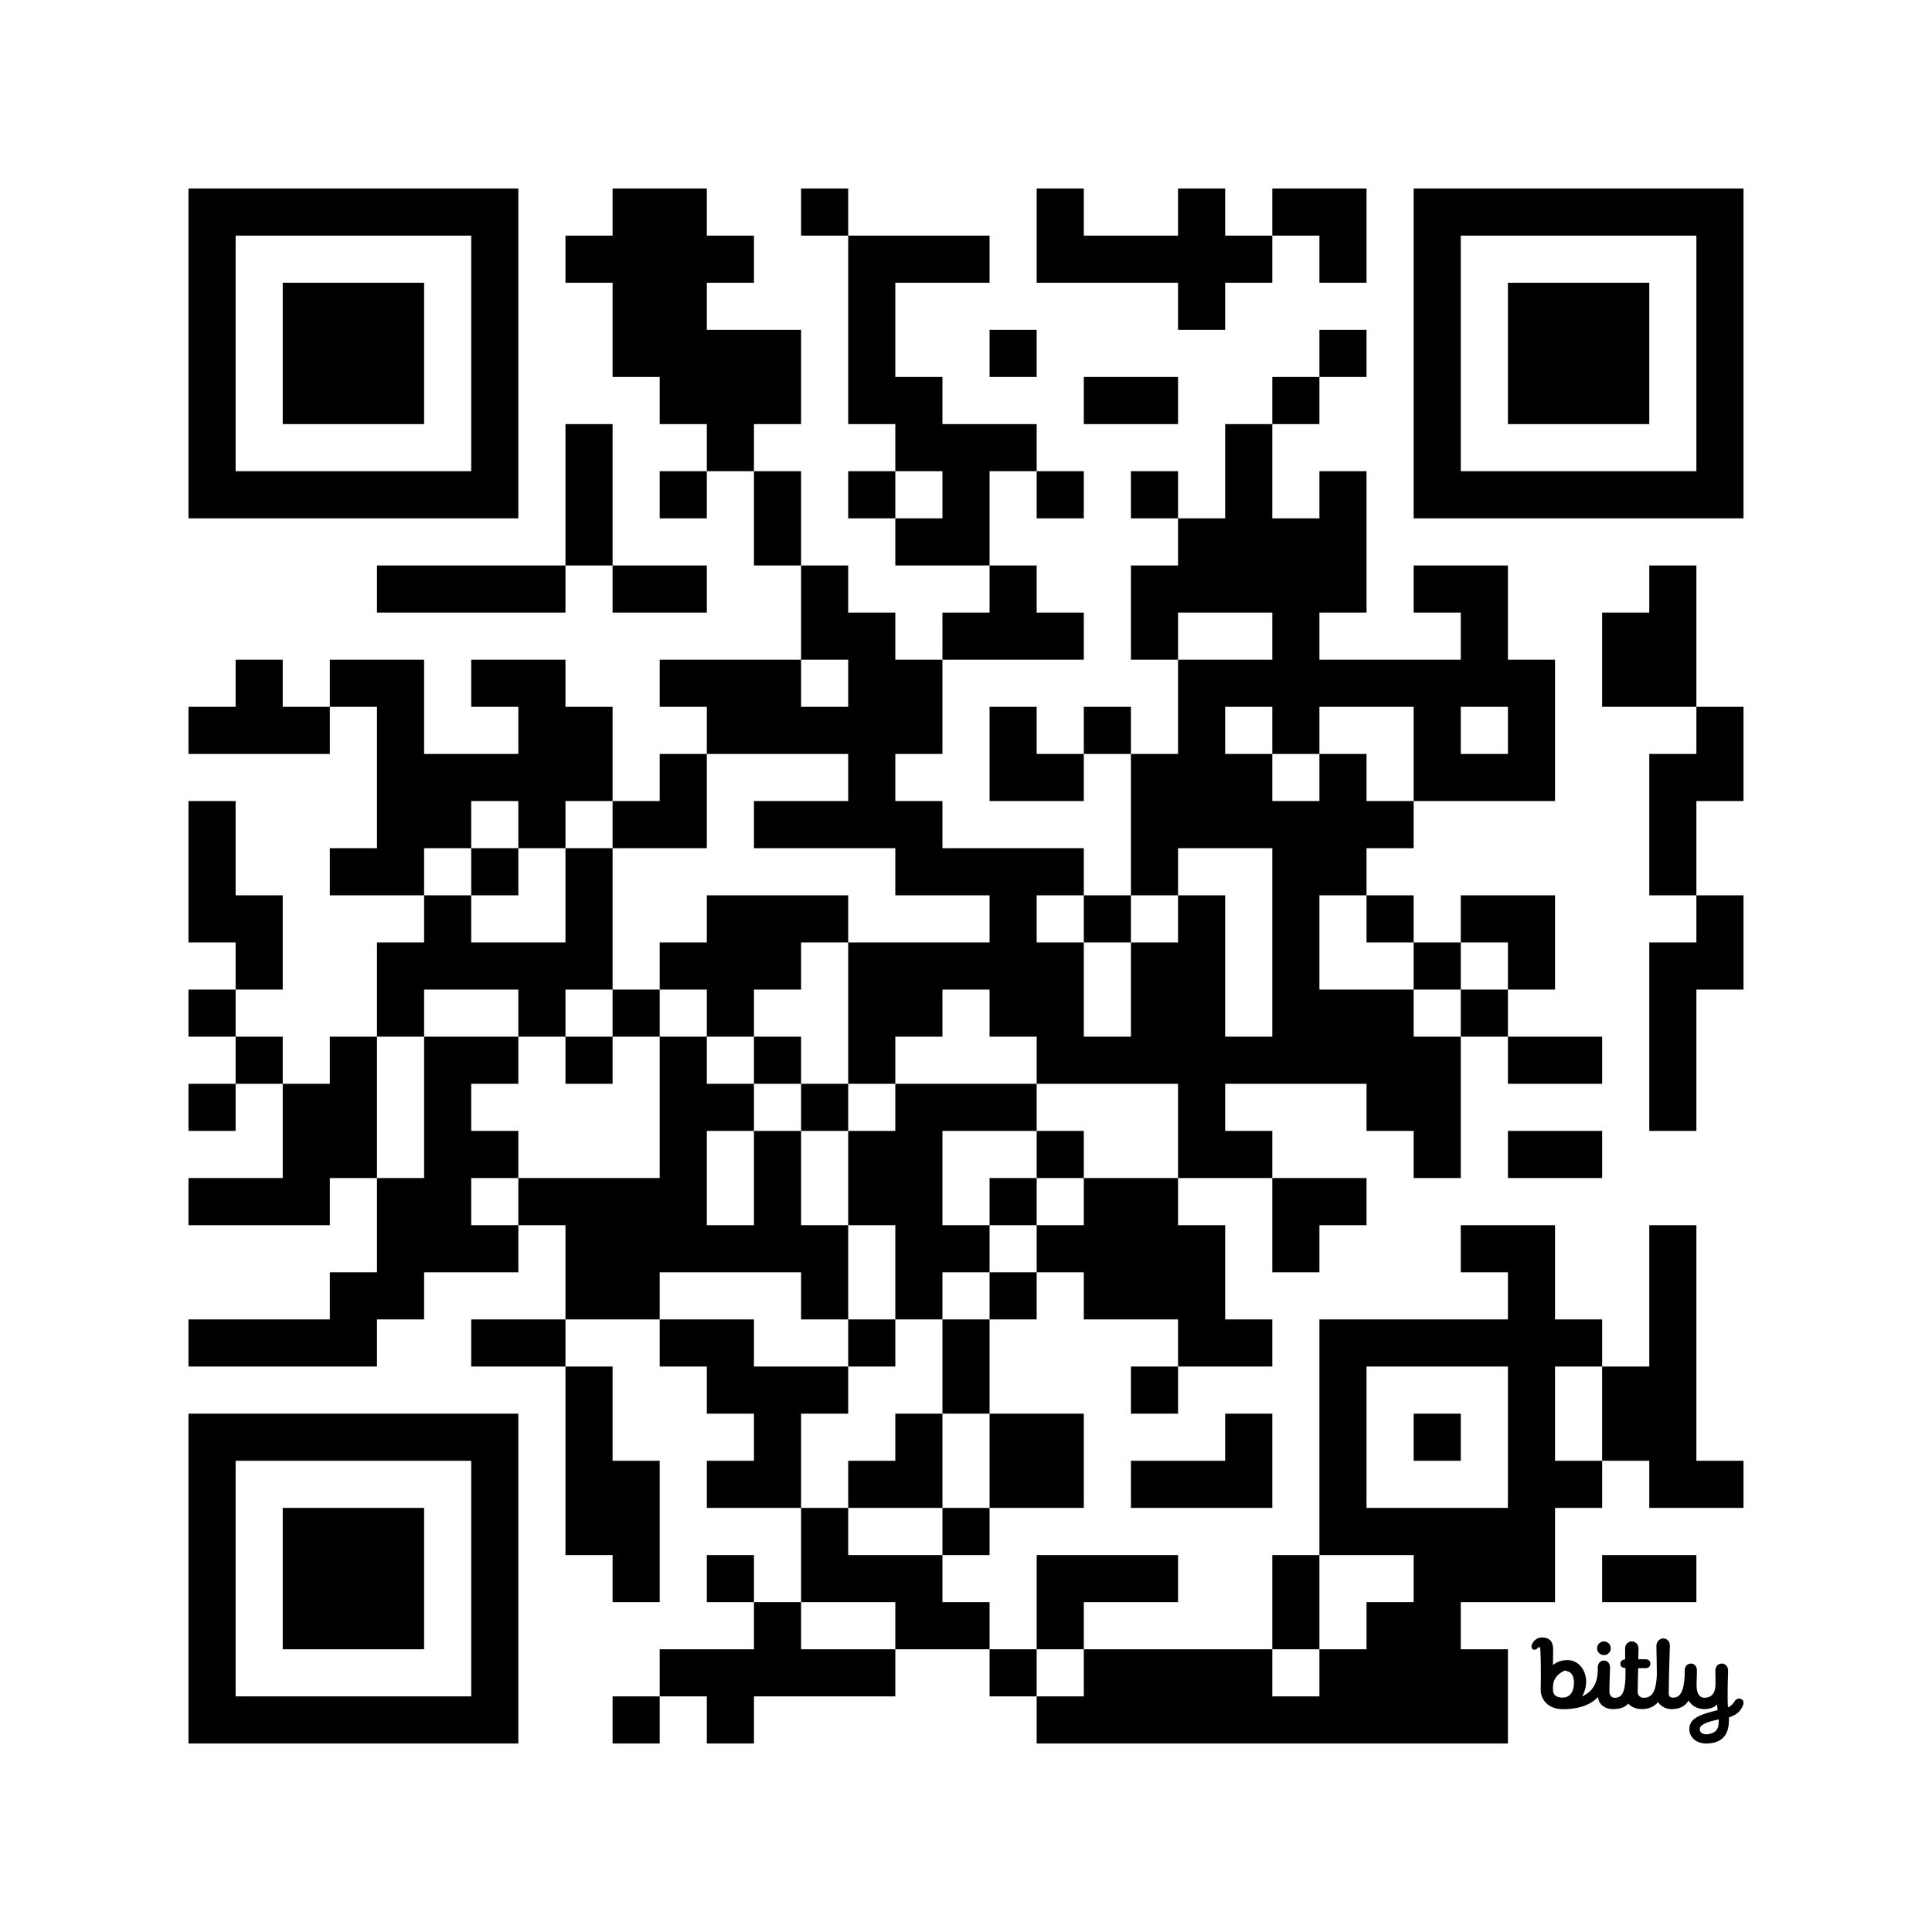
Courses@IISc (Aug 2025 Term)
Registration
1-2 weeks (Aug 1st – Aug 14)…try courses on first week
Homework(s)
Midterm(s)
Presentation(s)
Drop date (without transcript entry)
20 Aug-30 Sept
Drop date (with W transcript entry)
4 Oct - 22 Oct
Last Date of Classes
14 Nov
Final Exam
21 Nov-2 Dec
Grading Complete
8 Dec (deadline if you need to discuss final exam scores, etc. Travel planning)
https://bit.ly/iisc-academics

Slide 8
Some committees
Research/Project Advisor: Advises student on all research and academic matters. Supervises progress. Signs on all documents. Keep them informed (good & bad). Meet definitely once a week at least. Consult on any and every decision!
Faculty Advisor: Assigned for 1-2 terms till Project Advisor assigned to MTech(CDS). Signs on all documents. Keep them informed. Consult each month.
Department Curriculum Committee (DCC): Takes care of all academic matters of students at the department. Concerns, issues, etc. that is beyond the Advisor.
Senate Curriculum Committee (SCC): Takes care of academic matters at the Institute Level
Senate Committee on Research Conferments (SCRC): Makes research candidacy, upgradation, etc. decisions on each student
Chairperson (CDS): If you get into trouble… ☹
Dean (Academic): If you get into bad trouble… ☹ ☹

Slide 9
PhD Student Timelines
End of First Year
Complete Research Training Program (RTP) with at least one Math, Algorithms or equivalent course.
24 credits for direct Ph.D. (only prior BE/BTech)
12 credits for regular Ph.D. (prior ME/MTech)
Minimum CGPA of 7.0 out of 10.0
Identified research topic and initiated preliminary work.
End of Second Year
Completed all modules of DS 200: Research Methods Course.
Developed a comprehensive research plan with a clear thesis timeline.
Contributed towards a conference/journal publication.
Successfully passed the Comprehensive Exam.
Finished the mandatory Student Assistantship Programme (SAP) TA role.
End of Third Year
Published first-author work in a conference or journal.
Consulted advisor to evaluate progress on thesis work.
Completed Annual PhD Review and submitted in SLcM before July 31st
End of Fourth Year
Completed a major portion of the thesis with major publications.
Considered presenting thesis Colloquium.
Doctoral Dissertation to be submitted within 1 month of Colloquium.
Reflected on post-Ph.D. career options.
Completed Annual PhD Review.
End of Fifth Year
Should have presented thesis Colloquium and submitted Doctoral Dissertation.
Ph.D. Colloquium must be completed by the fifth year or earlier. Scholarship will be stopped after Year 5.

Slide 10
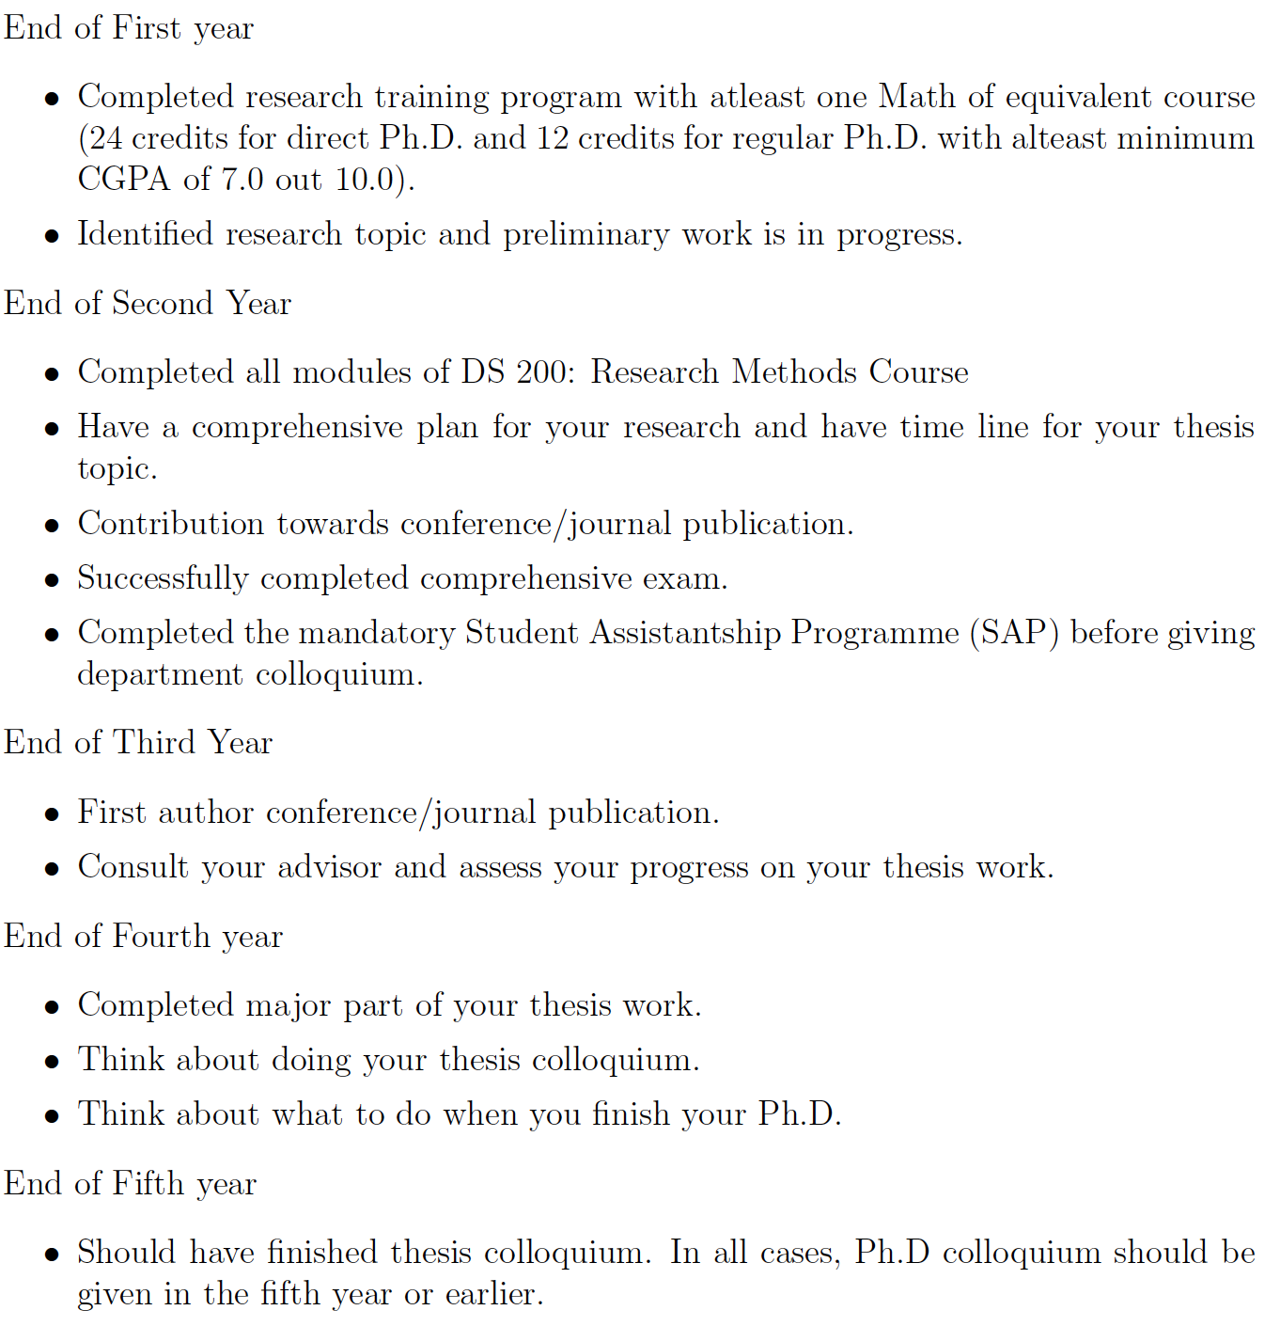

Slide 11
MTech Research Student Timelines
End of First Semester
Have identified Research Advisor. Identified research topic.
Complete most of Research Training Program (RTP) with at least one Math, Algorithms or equivalent course.
12 credits with Minimum CGPA of 7.0 out of 10.0
End of 1 Year
Complete Research Training Program (RTP)
Made progress on your research topic and actively working on it.
Consider Upgrading to PhD if you are excited by your research and have CGPA of 8.0 or above.
Short time to doctoral work, higher impact, scholarship opportunities, arrears (~Rs. 1.5L)
End of 1.5 Years
Completed all modules of DS 200: Research Methods Course.
Contributed towards a conference/journal publication.
End of 2 Years
Published first-author work in a conference or journal.
Submitted M.Tech. Thesis and defended it.
Consider Continuation for a PhD.
Continue on as a PhD student and expand on your research work.

Slide 12
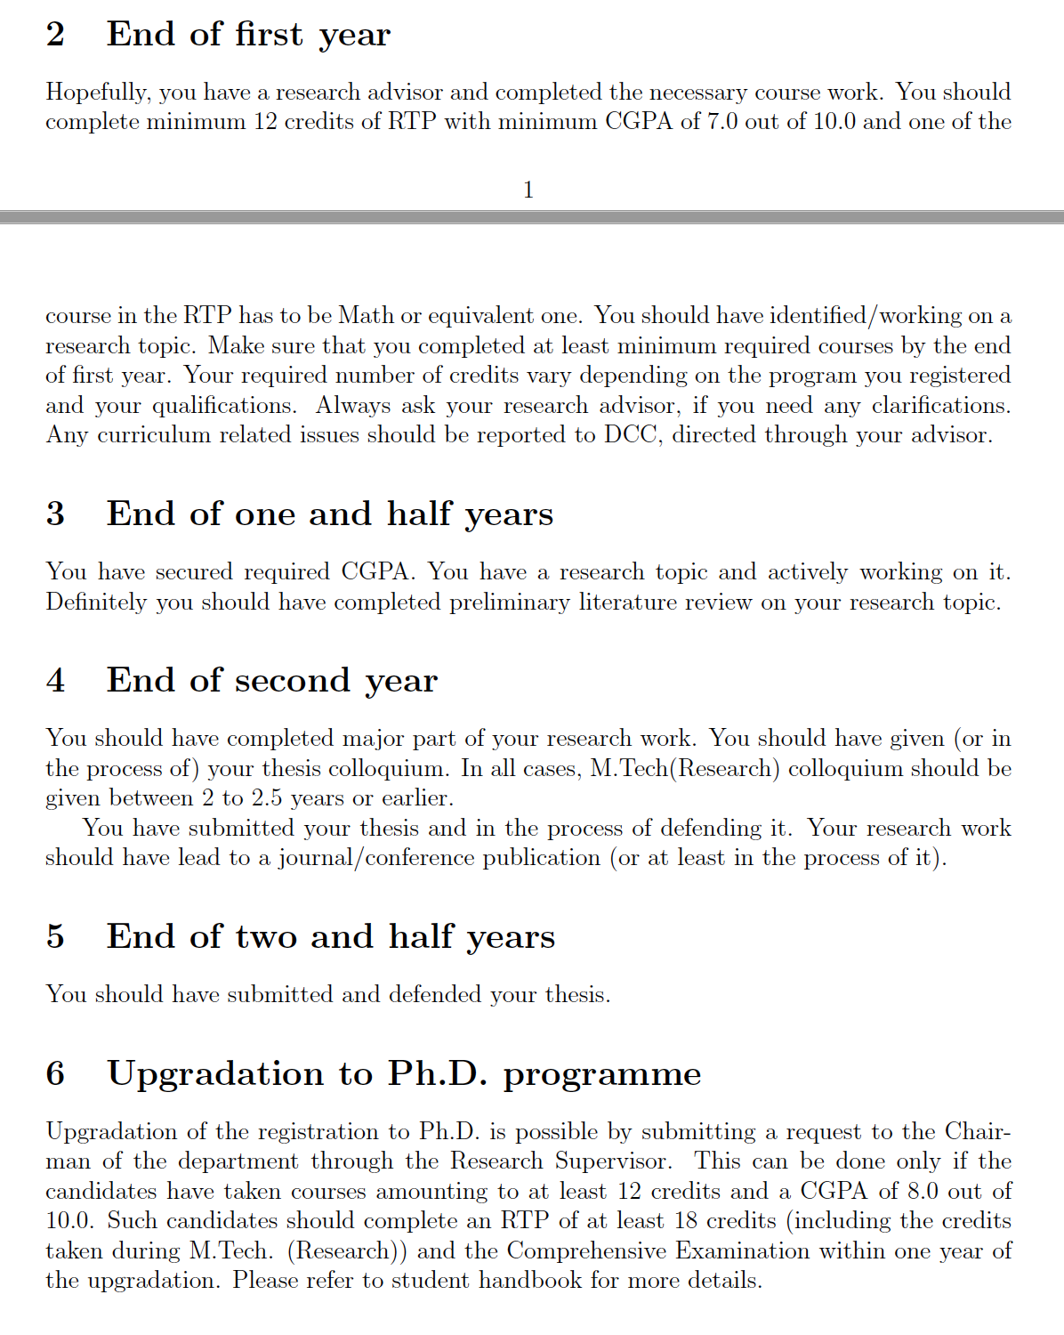
MTech Research Student Timelines

Slide 13
M.Tech. (CDS) Course Structure
Duration: 24 Months (Aug 2025 - June 2027)
Hard Core: 14 credits
Courses: 13 credits
Research Methods: 1 credit (soft skills course)
Soft Core: 10 credits minimum (atleast three courses)
Dissertation: 28 credits (from May 2026 – June 2027)
Electives: 12 credits (Students may credit CDS electives/soft core or other department courses)
Total: 64 credits (31 Credits for the First Year is Mandatory)

Slide 14
M.Tech. (CDS) Project Advisor
Option to choose a Project Advisor at the end of the first semester.
A list of projects from the interested faculty will be available by end of Sep 2025. Decide which faculty to approach and discuss with them by Nov 2026.
Plan early. Each Advisor allowed only 4 M.Tech.(CDS) students, relaxed only in some cases. Advisors may look for specific skills and coursework. Have 2-3 lab options.
Finalise your advisor by course registration date in Jan term and complete paperwork and SLcM Mapping. Consult with Advisor on courses for Jan 2026.
Once selected, you cannnot switch to another faculty, except in unusual cases.
Project evaluations will happen in Sep 2026 (summer, 4 credit), Jan 2027 (mid-term, 8 credit) and June 2027 (final evaluations, 16 credit)
Student, along with the advisor, will coordinate the dates with two faculty examiners assigned by DCC, at a mutually convenient time before a cut-off date set by DCC.
DCC recommends the following deadlines for finishing evaluations
Summer Term: Sept 15, 2026;
Mid Term: Jan 15, 2027;
Final Evaluation: June 10th, 2027 (Project Report Submission Deadline: June 20th, 2027)

Slide 15
Course Registration http://sap.iisc.ac.in (IISc Network/VPN Only)
Class Schedule: https://indianinstituteofscience.sharepoint.com/CDS
https://cds.iisc.ac.in/courses/schedule/
Online Resources for New Students:
https://cds.iisc.ac.in/internal-resources/student-resources/
http://cds.iisc.ac.in/news/cds-incoming-students-orientation/
https://cds.iisc.ac.in/academics/departmental-curriculum-committee-dcc/
https://cds.iisc.ac.in/courses/schedule/
https://cds.iisc.ac.in/internal-resources/department-wellness-committee/

Slide 16
General Guidelines
Biometric attendance and signing on attendance register in CDS office mandatory for all CDS students (once before 10 AM and once after 5 PM)
The above is required for monthly scholarship processing
Scholarship request has to raised in SAP before 15th of every month.
Minimum 75% attendance is required for course, if informed by instructor
Max 30 working days leave in year
Leave of absence to be raised in SAP with prior approval of advisor.

Slide 17
Upgradation to PhD
12 credits or more, >=8.0 CGPA, from all courses taken (MTech Research)
24 credits or more, >=8.0 CGPA, from all courses taken (MTech Course)
Request from student to Chair. Recommendation given by advisor.
Presentation made to department committee
Recommendation approved by SCRC
PhD-level pay arrears, scholarship opportunities
Typically at end of 1st or 2nd semester
Talk to research advisor early on, if interested
Plan courses, thesis topics, etc.

Slide 18
Continuation to PhD
Within 2 weeks of submission of MTech(Res) thesis
Timely completion (2yrs), research publication is expected

Slide 19
Opportunity at IISc
World-class research work, even by course students.
Opportunities to present work at international conferences.
Internships, if approved by advisor. Formal approval is required.
Fellowship funds and appropriate use.

Slide 20
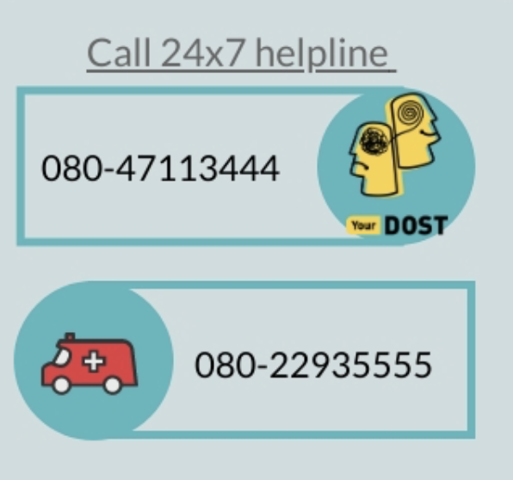
Department wellness committee
Faculty Members:
Prof. Jayant Haritsa (Convener)
Dr. Lakshmi J. (Co-convener)
Dr. Vaanathi Sundaresan (Member)
Dr. Danish Pruthi (Member)
Student Members:
Gourab Panigrahi (MATRIX Lab)
Roopkatha Banerjee (DREAM Lab)
Contact at Institute Wellness Centre: B.G. Shridhar (shridharbg@iisc.ac.in), M.S.Savitha (savithams@iisc.ac.in), Consulting Psychologists, IISc Wellness Centre
More information available at: https://wellness.iisc.ac.in

