Slide 1

CDS-DCC Student Orientation
DCC: Department Curriculum Committee
DCC Convenor: Phani Motamarri
DCC Faculty Members: Yogesh Simmhan, Sathish Vadhiyar,
Chirag Jain, Aditya Konduri and Anirban Chakraborty
DCC Student Representatives
MTech: Tathagata Ghosh <tathagatag@iisc.ac.in>
MTech(Research): Maunil Hitesh Shah <maunilshah@iisc.ac.in>, Anirudh G <saianirudhg@iisc.ac.in>
PhD: Parvesh Barak parveshbarak@iisc.ac.in,
Key information for incoming CDS students
(also available on CDS website -> Resources -> Students)
2026-07-31

Slide 2
Important Academic Details
Student Handbook (for each incoming batch, https://bit.ly/iisc-sih-2026)
  Rules and regulations applicable to you at IISc
Scheme of Instructions (annual/per-term, https://bit.ly/iisc-soi-2025-aug )
  Courses expected to be offered in each department, faculty
Course Time-Table (each semester)
  Schedule of courses actually offered, and final exam dates
  Confirm with department page/instructor
    https://cds.iisc.ac.in/courses/schedule/
  Check department website/broadcast mail for first lecture date/venue
  Other departments courses & academic schedule
    https://bit.ly/iisc-academics

Slide 3
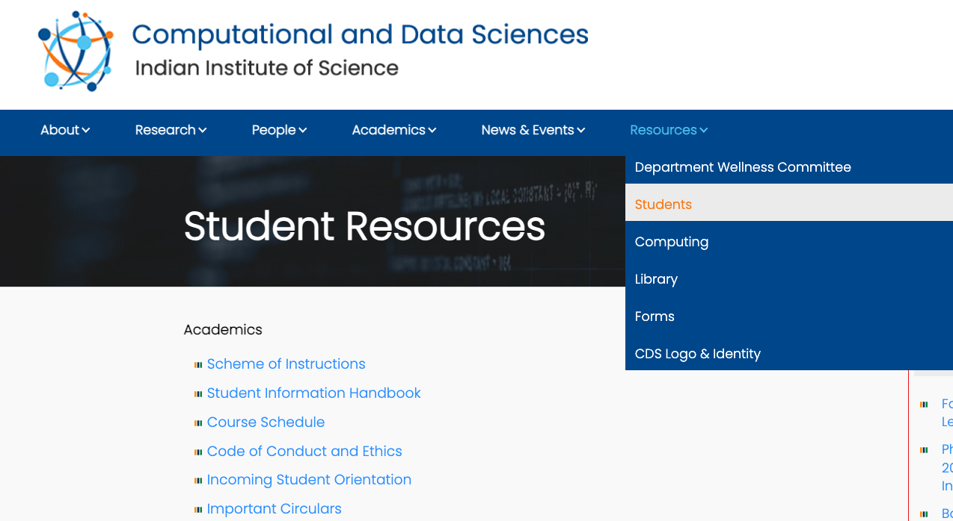
Important Academic Details

Slide 4
Courses@IISc
Course Code
  XY zzz … E.g. DS 200, E0 253
  XY: Department/Division offering course, e.g. DS=CDS, E0=CSA
  zzz: course number and level. 200 level is beginner, 300 level is advanced
Credits
  n:m … E.g. 3:1, 3:0, 2:0
  n: number of lecture hours per week.
    3 is typically 2*1.5hrs or 3*1hr. 2 is typically 2*1hr or 1*2hrs.
  m: Lab effort required (highly variable by course). May include project component, tutorials, programming homeworks
  Total credits for a course is m+n

Slide 5
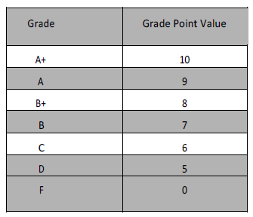
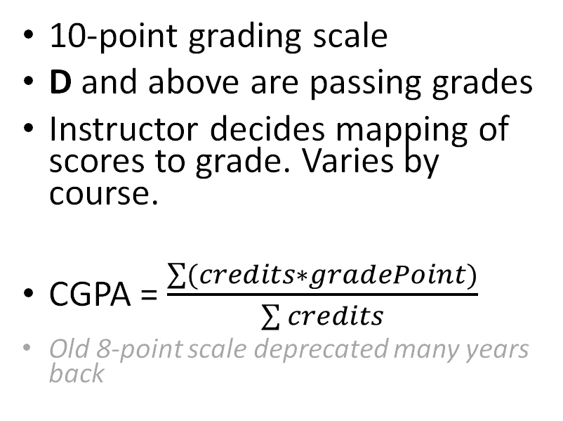
Courses@IISc
10-point grading scale
D and above are passing grades
Instructor decides mapping of scores to grade. Varies by course.
CGPA = $\frac{\sum{(credits∗gradePoint)}}{\sum{credits}}$
Old 8-point scale deprecated many years back
Attendance Policy depends on course and instructor. May require 75% or more to complete the course. Encourage you to attend lectures regularly to ensure progress.

Slide 6
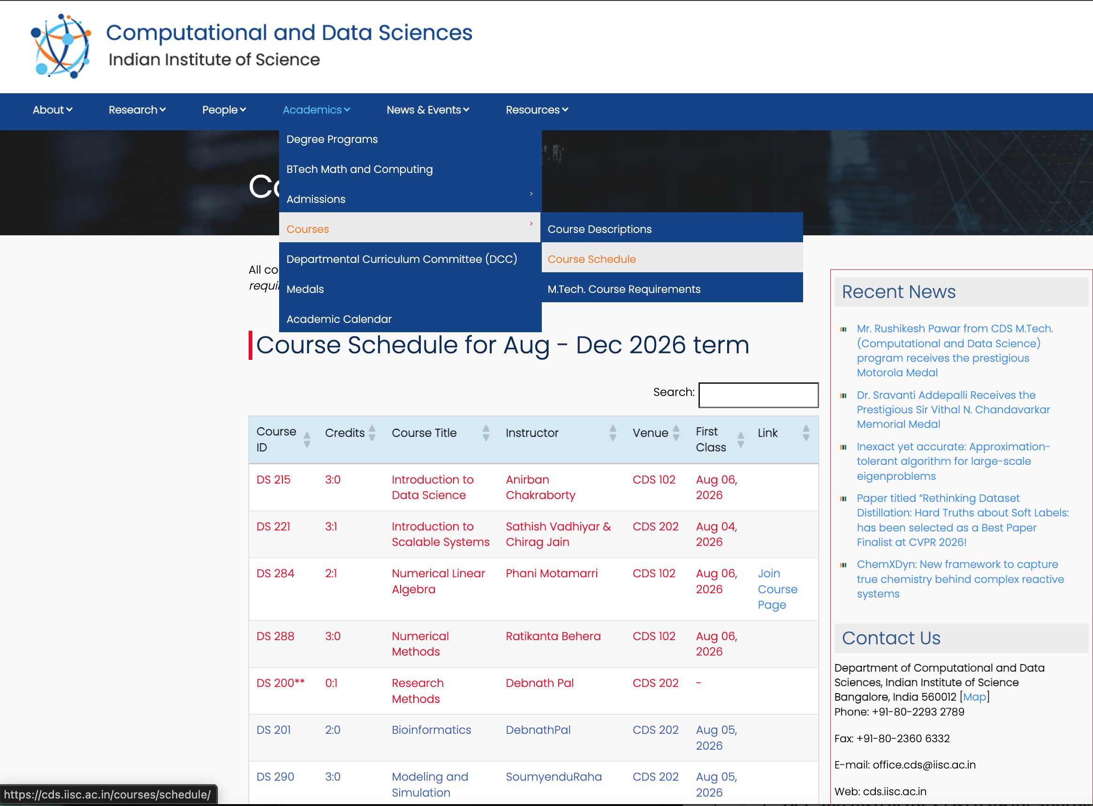
    https://cds.iisc.ac.in/courses/schedule/

Slide 7
Courses@IISc (Aug 2026 Term)
Registration
  1-2 weeks (Aug 1st – Aug 14)…try courses on first week
Homework(s)
Midterm(s)
Presentation(s)
Drop date (without transcript entry)
  20 Aug- 22 Sept
Drop date (with W transcript entry)
  26 Sept - 26 Oct
Last Date of Classes
  13 Nov
Final Exam
  20 Nov-2 Dec
Grading Complete
  7 Dec (deadline if you need to discuss final exam scores, etc. Travel planning)
https://bit.ly/iisc-academics

Slide 8
Some committees
Research/Project Advisor: Advises student on all research and academic matters. Supervises progress. Signs on all documents. Keep them informed (good & bad). Meet definitely at least once a week. Consult on any and every decision!
Faculty Advisor: Assigned for 1-2 terms till Project Advisor assigned to MTech(CDS). Signs on all documents. Keep them informed. Consult each month.
Department Curriculum Committee (DCC): Takes care of all academic matters of students at the department. Concerns, issues, etc. that is beyond the Advisor.
Senate Curriculum Committee (SCC): Takes care of academic matters at the Institute Level
Senate Committee on Research Conferments (SCRC): Makes research candidacy, upgradation, etc. decisions on each student
Chairperson (CDS): If you get into trouble… ☹
Dean (Academic): If you get into bad trouble… ☹ ☹

Slide 9
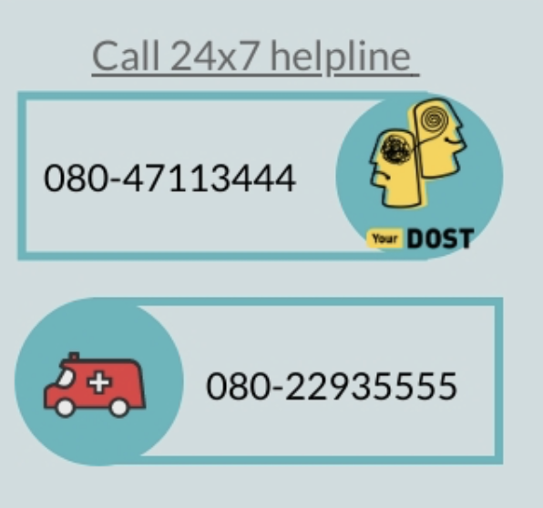
Department wellness committee
Faculty Members:
Prof. Murugesan Venkatapathi (Convener)
Dr. Lakshmi J. (Co-convener)
Dr. Vaanathi Sundaresan (Member)
Dr. Danish Pruthi (Member)
Student Members:
Gourab Panigrahi (MATRIX Lab)
Roopkatha Banerjee (DREAM Lab)
Contact at Institute Wellness Centre: B.G. Shridhar (shridharbg@iisc.ac.in), M.S.Savitha (savithams@iisc.ac.in), Consulting Psychologists, IISc Wellness Centre
More information available at: https://wellness.iisc.ac.in

Slide 10
PhD Student Timelines
End of First Year
Complete Research Training Program (RTP) with at least one Math, Algorithms or equivalent course.
  24 credits for direct Ph.D. (only prior BE/BTech)
  12 credits for regular Ph.D. (prior ME/MTech)
  Minimum CGPA of 7.0 out of 10.0
Identified research topic and initiated preliminary work.
End of Second Year
Completed all modules of DS 200: Research Methods Course.
Developed a comprehensive research plan with a clear thesis timeline.
Contributed towards a conference/journal publication.
Successfully passed the Comprehensive Exam.
Finished the mandatory Student Assistantship Programme (SAP) TA role.
End of Third Year
Published first-author work in a conference or journal.
Consulted advisor to evaluate progress on thesis work.
Completed Annual PhD Review and submitted in SLcM before July 31st
End of Fourth Year
Completed a major portion of the thesis with major publications.
Considered presenting thesis Colloquium.
  Doctoral Dissertation to be submitted within 1 month of Colloquium.
Reflected on post-Ph.D. career options.
Completed Annual PhD Review.
End of Fifth Year
Should have presented thesis Colloquium and submitted Doctoral Dissertation.
Ph.D. Colloquium must be completed by the fifth year or earlier. Scholarship will be stopped after Year 5.

Slide 11
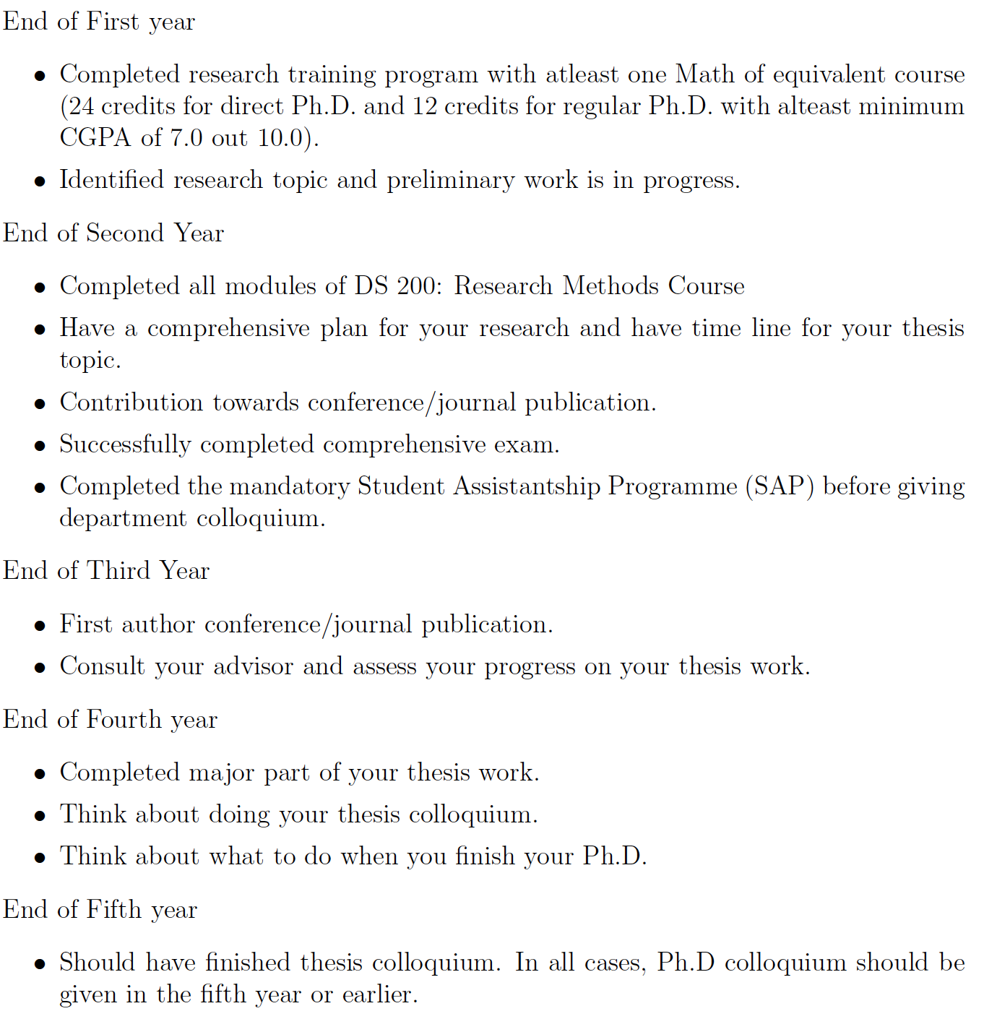

Slide 12
MTech Research Student Timelines
End of First Semester
Have identified Research Advisor. Identified research topic.
Complete most of Research Training Program (RTP) with at least one Math, Algorithms or equivalent course.
  12 credits with Minimum CGPA of 7.0 out of 10.0
End of 1 Year
Complete Research Training Program (RTP)
Made progress on your research topic and actively working on it.
Consider Upgrading to PhD if you are excited by your research and have CGPA of 8.0 or above.
  Short time to doctoral work, higher impact, scholarship opportunities, arrears (~Rs. 1.5L)
End of 1.5 Years
Completed all modules of DS 200: Research Methods Course.
Contributed towards a conference/journal publication.
End of 2 Years
Published first-author work in a conference or journal.
Submitted M.Tech. Thesis and defended it.
Consider Continuation for a PhD.
  Continue on as a PhD student and expand on your research work.

Slide 13
Typical CDS Course Plan for Research Students
MATRIX, FLAME, CSPL, NATL, QUEST(Computational Science and SciML Labs):
Numerical Linear Algebra, Numerical Methods, Introduction to Scalable Systems, Introduction to Data Science, Modelling and Simulations
MARS, DREAM, ATCG (Computer System labs):
Introduction to Data Science, Introduction to Scalable Systems, Introduction to Cloud Computing
NLP, VCL, VAL (AI labs):
Introduction to Data Science, Numerical Linear Algebra, Ethics in AI
BioMedia, MIG, BCL (AI in Medical, Biology related fields)
Introduction to Data Science, Numerical Linear Algebra
For other courses of interest look outside CDS, and consult with your initial guide.

Slide 14
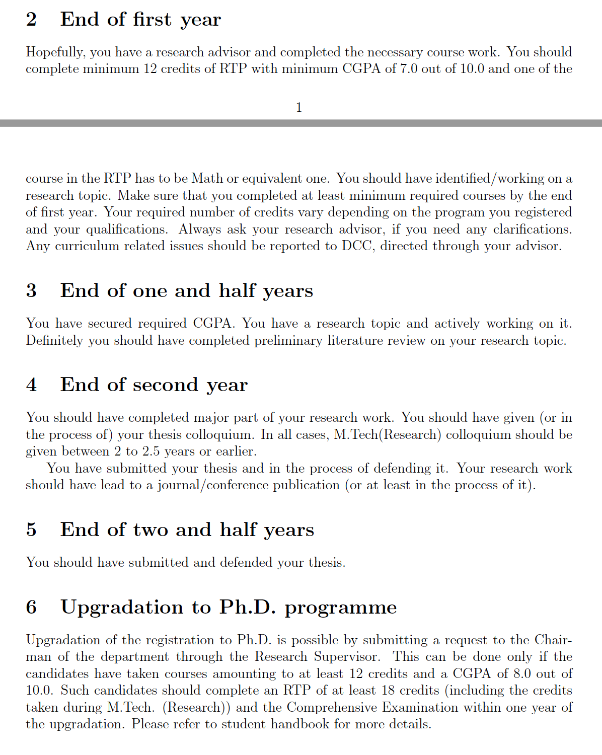
MTech Research Student Timelines

Slide 15
M.Tech. (CDS) Course Structure
Duration: 24 Months (Aug 2026 - May 2028)
Hard Core: 14 credits
  Courses: 13 credits
  Research Methods: 1 credit (soft skills course)
Soft Core: 10 credits minimum (atleast three courses)
Dissertation: 28 credits (from May 2026 – June 2027)
Electives: 12 credits (Students may credit CDS electives/soft core or other department courses)
Total: 64 credits (31 Credits for the First Year is Mandatory)

Slide 16
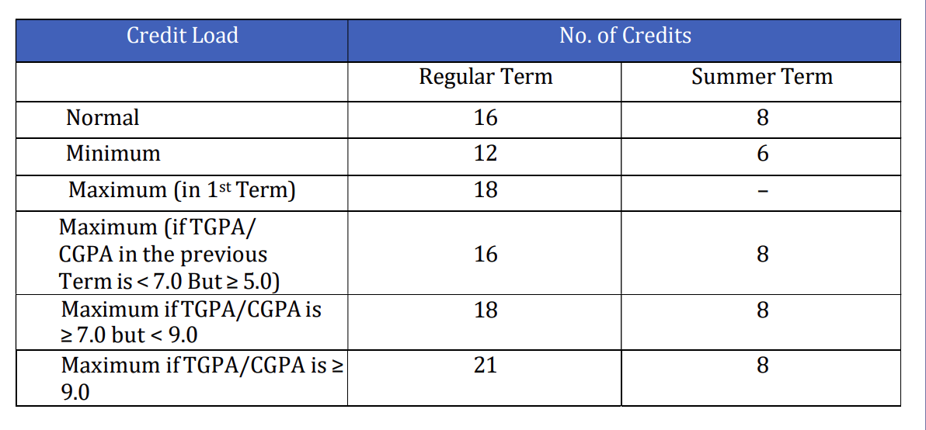
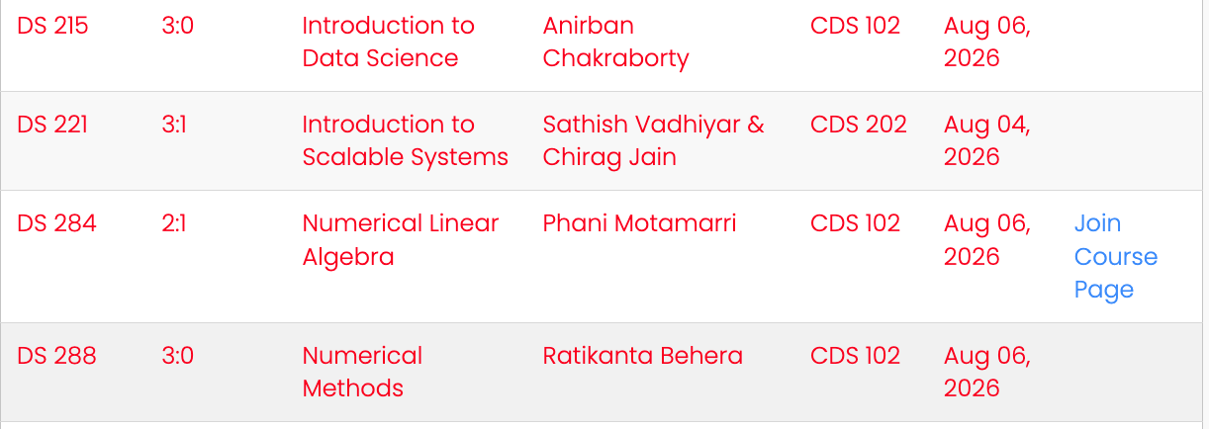
Credit Load (Mtech-Course)
Plan for 1st Semester (Hard core courses for Mtech-Course)

Slide 17
M.Tech. (CDS) Project Advisor
Option to choose a Project Advisor at the end of the first semester.
A list of projects from the interested faculty will be available by end of Sep 2026. Decide which faculty to approach and discuss with them.
  Plan early. Each Advisor allowed only 4 M.Tech.(CDS) students, relaxed only in some cases. Advisors may look for specific skills and coursework. Have 2-3 lab options.
Finalise your advisor before course dropping date in Jan 2027 term and complete paperwork and SLcM Mapping. Consult with Advisor on courses for Jan 2027.
  Once selected, you cannnot switch to another faculty, except in unusual cases.
Project evaluations will happen in Nov 2027 (midyear, 12 credit), and May 2027 (final evaluations, 16 credit).
  Grades will appear in your respective transcripts for both evaluations. Poor progress/performance can cause "F" grade, will not be able to graduate within 2 yrs.
  Student, along with the advisor, will coordinate the dates with two faculty examiners assigned by DCC, at a mutually convenient time before a cut-off date set by DCC.
DCC will inform the schedule of your evaluations in advance

Slide 18
Course Registration http://sap.iisc.ac.in (IISc Network/VPN Only)
Class Schedule: https://indianinstituteofscience.sharepoint.com/CDS
https://cds.iisc.ac.in/courses/schedule/
Online Resources for New Students:
https://cds.iisc.ac.in/internal-resources/student-resources/
http://cds.iisc.ac.in/news/cds-incoming-students-orientation/
https://cds.iisc.ac.in/academics/departmental-curriculum-committee-dcc/
https://cds.iisc.ac.in/courses/schedule/
https://cds.iisc.ac.in/internal-resources/department-wellness-committee/

Slide 19
General Guidelines
Biometric attendance and signing on attendance register in CDS office mandatory for all CDS students (once before 10 AM and once after 5 PM)
The above is required for monthly scholarship processing
Scholarship request has to raised in SAP before 15th of every month.
Minimum 75% attendance is required for course, if informed by instructor
Max 30 working days leave in year
  Leave of absence to be raised in SAP with prior approval of advisor.
Any other vacation or leave to be requested and approved by advisor, before booking tickets, etc.

Slide 20
Q&A

Slide 21
IISc & Research
>>>>
Pop Quiz
<<<<

Slide 22
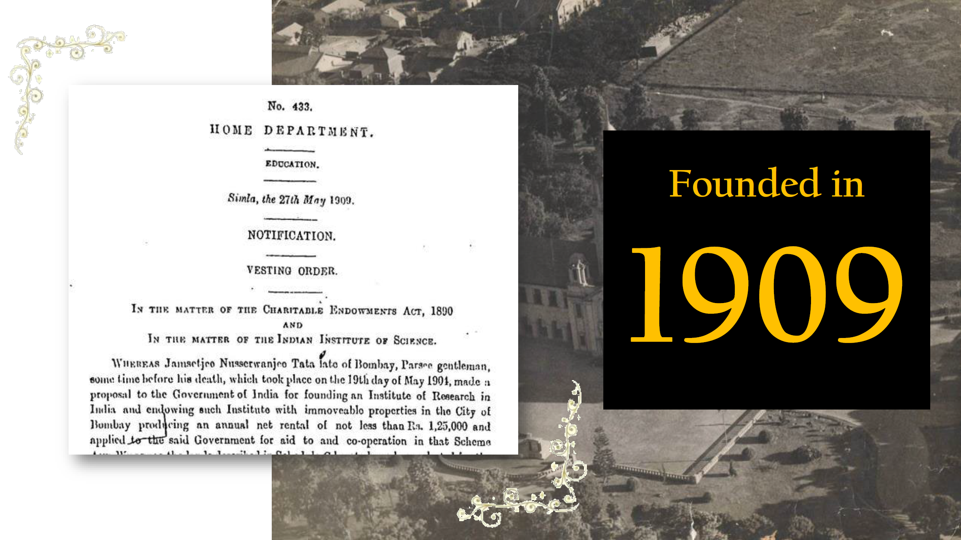
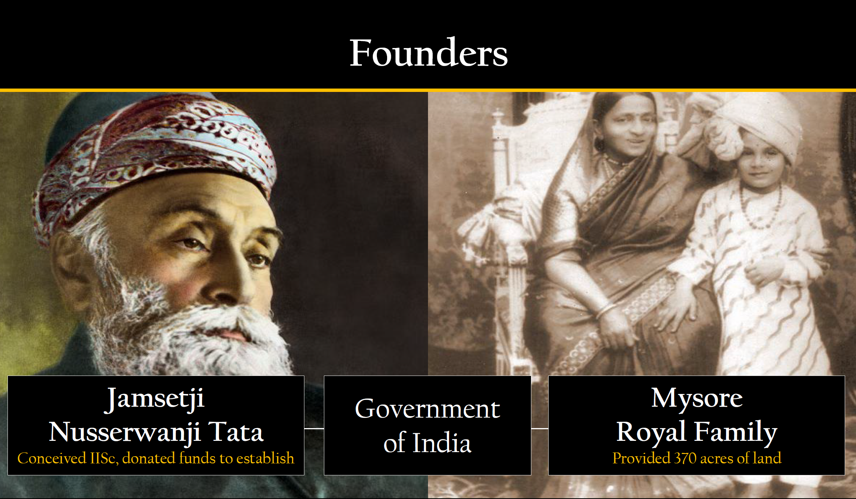
Indian Institute of Science
To promote original investigations in all branches of learning and to utilize them for the benefit of India.
Slide Credits Rajesh Sundaresan
Notes:
founding vision of IISc.
The 1893 voyage from Japan to Chicago alongside Swami Vivekananda profoundly shaped Jamsetji Tata's vision. At the time, Swamiji was preparing to introduce the Western world to Indian spiritualism.
1899 letter.
1909 founded.
IISc Founders Day March 3, JN tata Birthday
https://www.tata.com/newsroom/jamsetji-tata-letter-to-swami-vivekananda
https://www.indiatoday.in/education-today/gk-current-affairs/story/how-a-voyage-with-swami-vivekananda-inspired-jamshedji-tatas-vision-for-iisc-2688209-2025-03-03

Slide 23
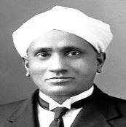
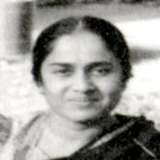
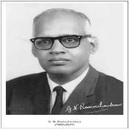
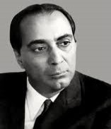
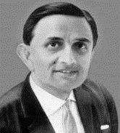
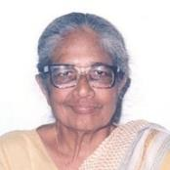
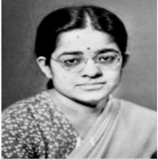
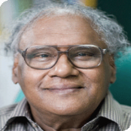
Legacy of Excellence in Science & Technology
CV Raman
Physics, Raman effect
Kamala Sohonie
Biochemistry, nutrition
GN Ramachandran
Physics, collagen structure
Homi Bhabha
Nuclear physics, atomic energy
Vikram Sarabhai
Astronomy, space research
Anna Mani
Physics, meteorology
Rajeswari Chatterjee
ECE, microwave technology
CNR Rao
Solid state & structural chemistry
Notes:
G. N. Ramachandran, Master's degree in Physics at the Indian Institute of Science under the tutelage of Prof. C. V. Raman. Established MBU at IISc. Indian physicist who was known for his work that led to his creation of the Ramachandran plot for understanding peptide structure. His discovery of the triple helical structure of collagen in 1955 and his analysis of the allowed conformations of proteins through the use of the 'Ramachandran plot' rank among the most outstanding contributions in structural biology, along with Pauling's description of the α-helix and Watson and Crick's discovery of the double helical structure of DNA.
C.V. Raman is famous for discovering the Raman Effect, a phenomenon where light changes wavelength after scattering off molecules, earning him the 1930 Nobel Prize in Physics and making him the first Asian to win a science Nobel. First Indian director of IISc.
Rajeshwari Chatterjee was an Indian scientist and an academic. She was the first woman engineer from Karnataka and described herself as an engineering-scientist. Chatterjee started building India's first microwave engineering research lab with her husband, her fellow scientist and colleague Sisir Kumar Chatterjee. Microwave research was still in its infancy. Chair of ECE.
Kamala Sohonie was an Indian biochemist who in 1939 became the first Indian woman to receive a PhD in a scientific discipline. Her acceptance into and work at the Indian Institute of Science, Bengaluru, paved the way for women to be accepted into the institution for the first time in its history.
Anna Mani (1918-2001) was a pioneering Indian physicist and meteorologist known for making India self-reliant in weather instrumentation, developing the ozonesonde (a balloon-borne ozone sensor), and her significant work on solar radiation, ozone, and wind energy, paving the way for renewable energy in India. She was a trailblazer for women in science, becoming the Deputy Director General of the Indian Meteorological Department (IMD) and establishing crucial weather monitoring systems.
Vikram Sarabhai, the father of India's space program, was a significant figure at the Indian Institute of Science (IISc), joining in the 1940s as a research scholar under Sir C.V. Raman after World War II interrupted his Cambridge studies, where he worked on cosmic rays and published his findings, also meeting Homi J. Bhabha at IISc, which laid groundwork for India's scientific institutions
Homi Bhabha: In 1939, Homi Bhabha, the man who was to found India’s atomic energy programme and loom like a Colossus over Indian science until his death in the mid-1960s, had gone to Cambridge a decade before Vikram. […] He had been holidaying in India when the war broke out. The IISc had offered him a readership which he had accepted. […] It was an extraordinary circumstance then that brought these two gifted individuals together.
Prof. C.N.R. Rao is a legendary Indian chemist deeply connected to the Indian Institute of Science (IISc) (IISc), serving as its Director from 1984 to 1994, establishing Solid State Chemistry at IISc, and remaining an Honorary Professor, renowned globally for his pioneering work in solid-state chemistry, nanomaterials, and materials science, influencing generations of scientists and contributing significantly to Indian science policy.

Slide 24
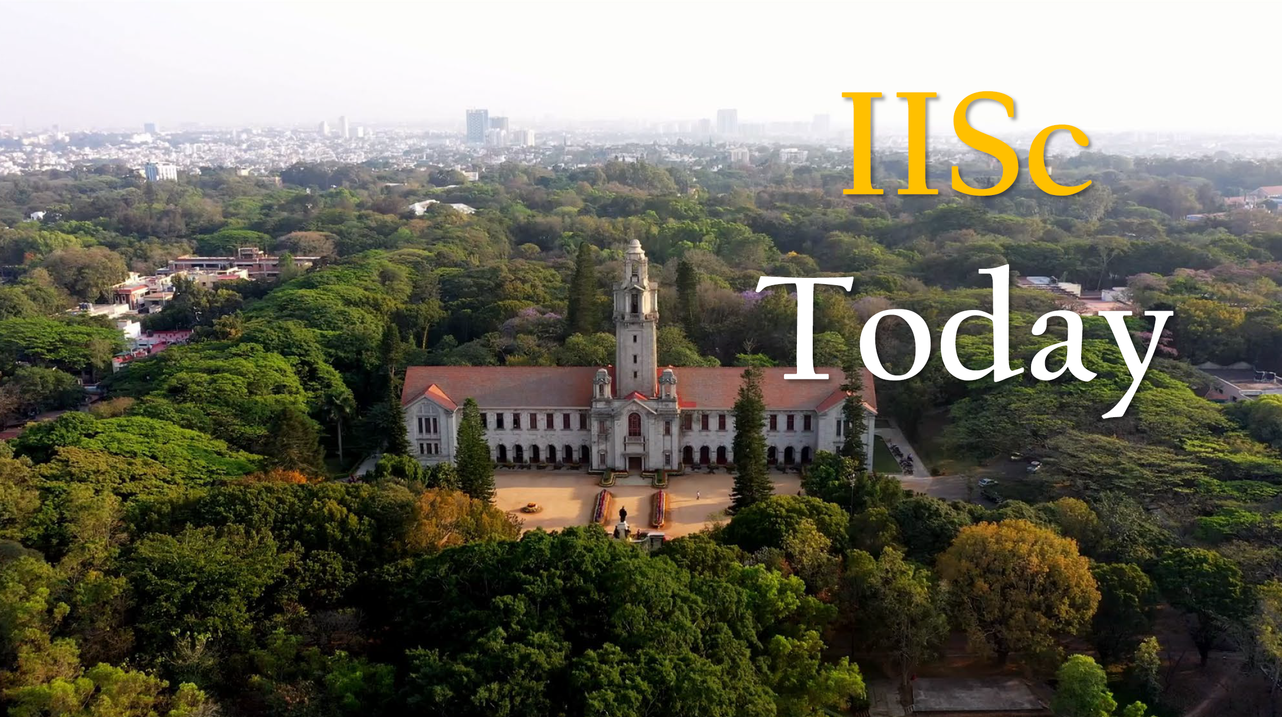
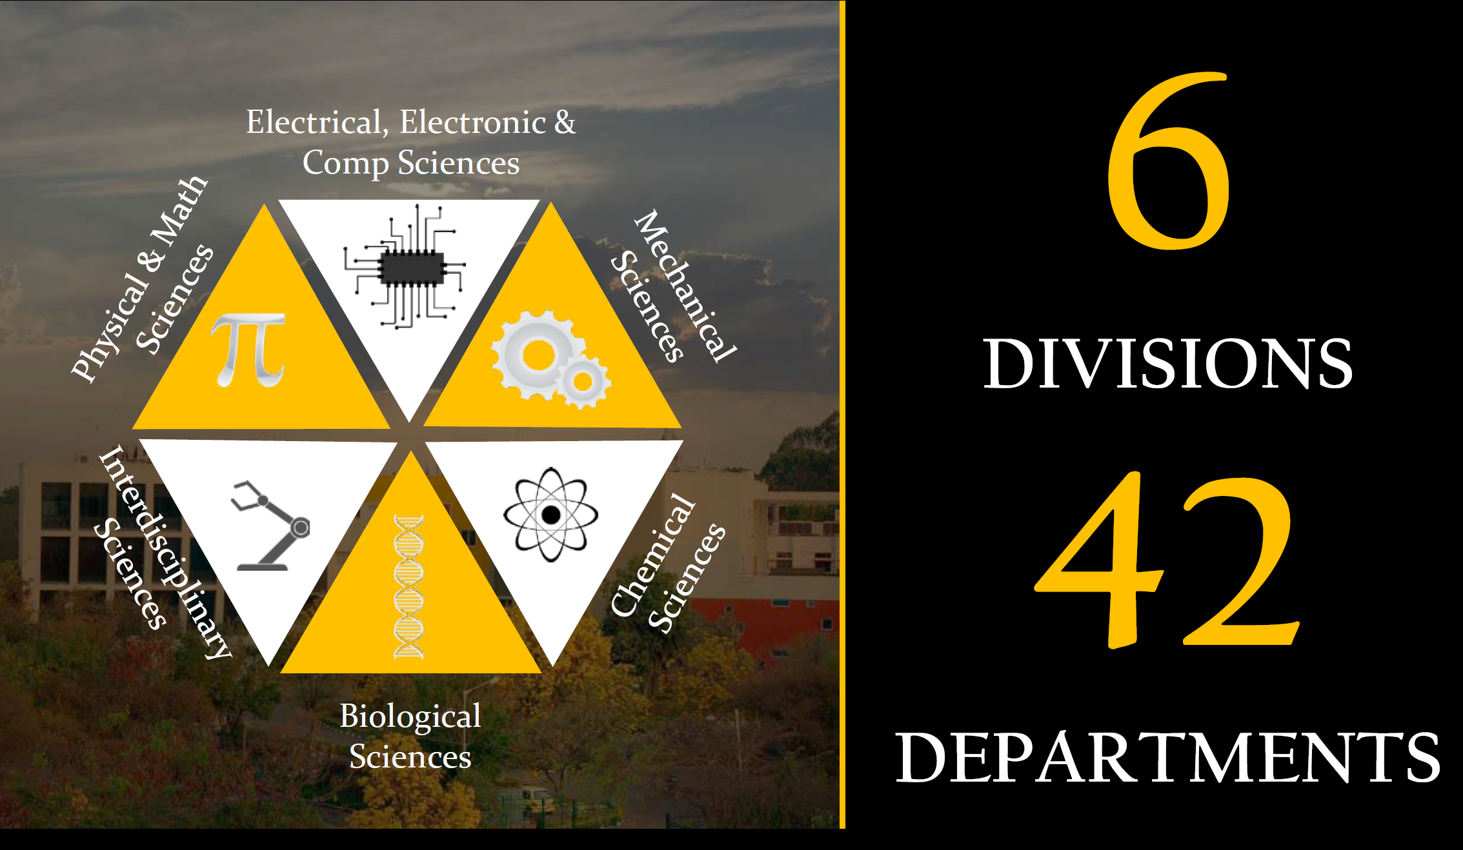
Indian Institute of Science
Slide Credits Rajesh Sundaresan

Slide 25



IISc at a Glance
  5500+ STUDENTS ON ROLL
  3000+ PUBLICATIONS/YEAR
  700+ COURSES
  500+ FACULTY & SCIENTIFIC STAFF
#1 University (2016-2025)
#1 in Research (2021-2025)
#221 World Ranking (2027)
#51-100 in Data Science & AI (2027)
#1
in citations per faculty (2022-2023)​
#201-250 World Ranking (2026)
#101-125 Engineering and Computer Science (2026)
9.8 #Students per Faculty Ratio
Institution of Eminence (IoE) since 2018

Slide 26
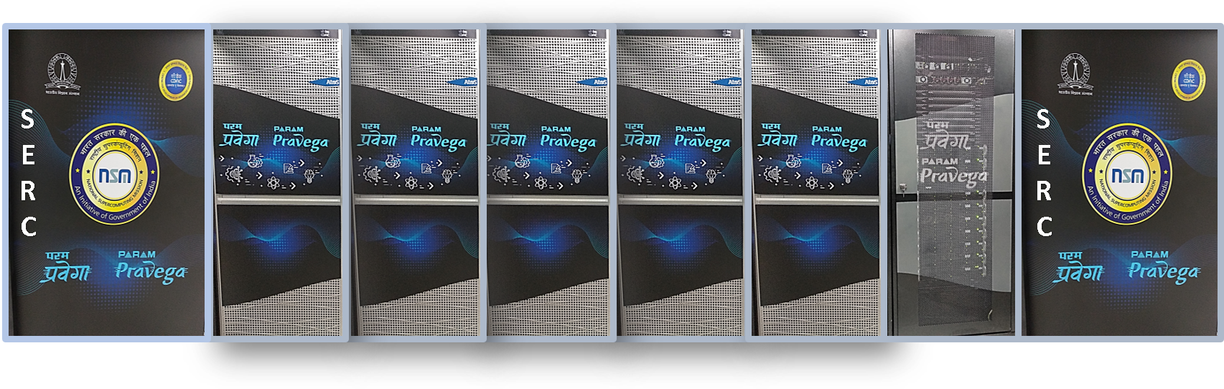
Supercomputing Facility
Supercomputer Education and Research Center (SERC)
(Usually) Runs the fastest academic supercomputers in India
Param Pravega, 2022 (3.3PF) -> ???, 2026 (~8.5PF)
  21k CPU cores, 80 V100 GPUs
Notes:
Regular CPU nodes: CPU nodes are built using Intel Xeon Cascade Lake 8268 2.9 GHz processors in a 2-socket configuration with 48 cores, 192GB RAM (4 GB per core), and 480GB SSD local storage per node. There are a total of 428 such nodes on PARAM Pravega constituting 20,544 cores for CPU-only nodes for computations resulting in 1.9PF peak capability.
High-Memory CPU nodes: The system also hosts High-memory CPU-only nodes that are similar in configuration to the CPU-only nodes except that these high-memory nodes have higher RAM of 768 GB per node (16 GB per core). There are a total of 156 such nodes on this system yielding a maximum of 7488 cores for high-memory computations giving 0.694PF of peak computing capability.
GPU nodes: PARAM Pravega also hosts 40 GPU nodes. The CPU of each node consists of Intel Xeon G-6248 2.5 GHz processor in a 2-socket configuration with 40 cores, 192GB RAM and 480GB SSD local storage. The GPU of each node is made up of two Nvidia V100 Tesla 16GB (HBM2 device memory) GPU cards. Thus, the 40 GPU nodes consist of a total of 1600 host CPU cores and 80 Nvidia V100 cards. The accelerator nodes contribute a total of 0.688 PFs (0.128 (host cpus) + 0.560 (GPUs)) computational capability.

Slide 27
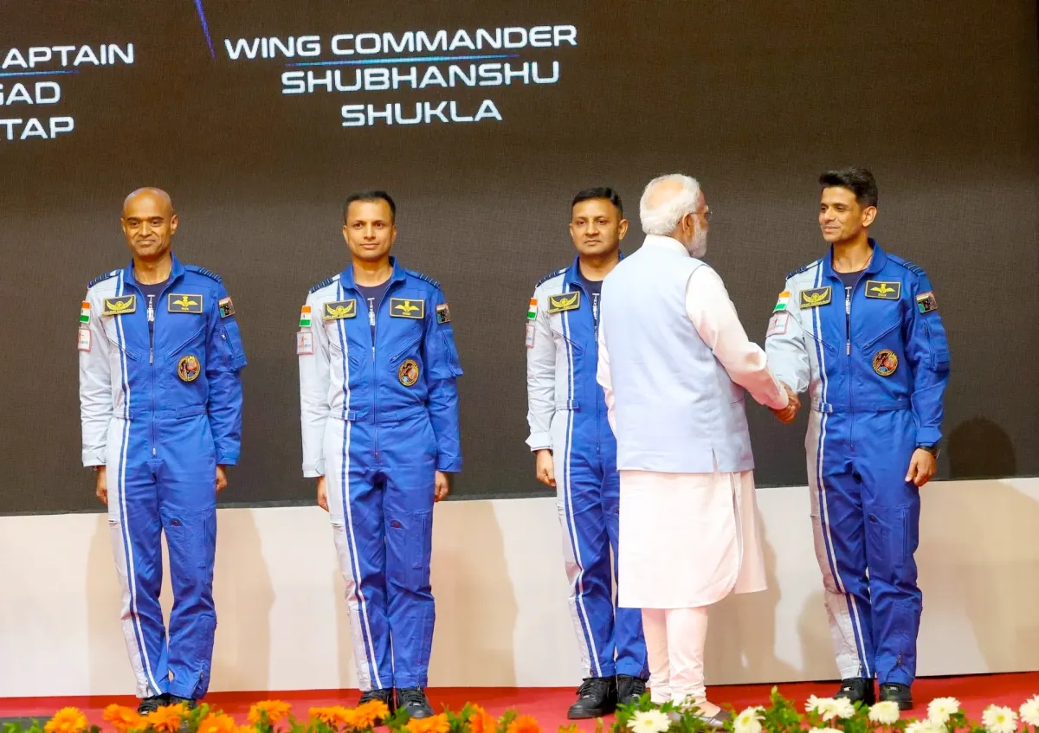
IISc and Gaganyaan Mission
Notes:
Group Captain Shubhanshu Shukla, an Indian astronaut training for Gaganyaan, flew to the International Space Station (ISS) on the Axiom-4 mission (June-July 2025), conducting microgravity experiments that directly benefit Gaganyaan, India's crewed spaceflight program, with valuable data on life support and crew operations, while IISc provided his advanced aerospace engineering education and hosted him for outreach, symbolizing the crucial link between premier Indian science institutions and ISRO's human spaceflight goals IISc Education: He holds an MTech in Aerospace Engineering from the Indian Institute of Science (IISc), highlighting the connection between top Indian academia and ISRO.

Slide 28
Upgradation to PhD
12 credits or more, >=8.0 CGPA, from all courses taken (MTech Research)
24 credits or more, >=8.0 CGPA, from all courses taken (MTech Course)
Request from student to Chair. Recommendation given by advisor.
Presentation made to department committee
Recommendation approved by SCRC
PhD-level pay arrears, scholarship opportunities
Typically at end of 1st or 2nd semester
  Talk to research advisor early on, if interested
  Plan courses, thesis topics, etc.

Slide 29
Continuation to PhD
Within 2 weeks of submission of MTech(Res) thesis
Timely completion (2yrs), research publication is expected

Slide 30
Get the true value of IISc!
Turn your M.Tech research into a Ph.D. journey

Slide 31
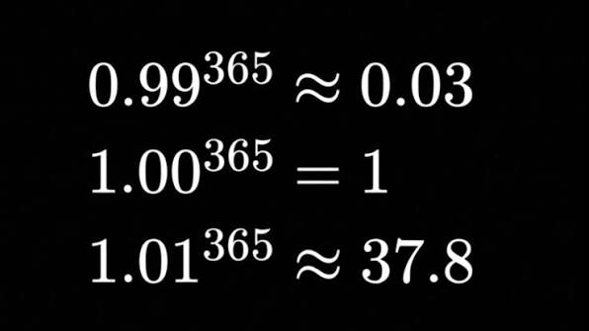

Slide 32
Thank you!

